Slide 1

Fundamentals of Electric Circuits
2020.6
Chapter 19
Two-Port Networks

Slide 2
Chapter 19 Two Port Networks
19.1 Introduction
19.2 Impedance parameters z
19.3 Admittance parameters y
19.4 Hybrid parameters h
19.5 Inverse hybrid parameters g
19.6 Transmission parameters T
19.7 Inverse Transmission parameters
19.8 Interconnection of Networks

Slide 3
What is a port?
19.1 Introduction
It is a pair of terminals through which a current may enter or leave a network.

Slide 4
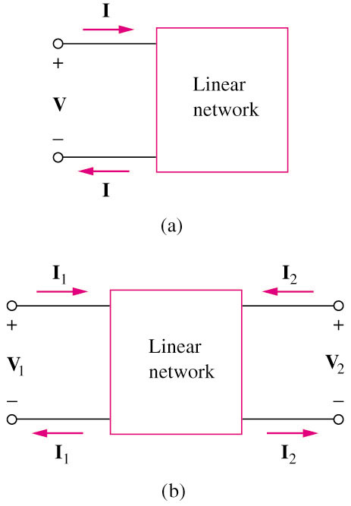
The current entering one terminal of a pair leaves the other terminal in the pair.
One port or two terminal circuit
Two port or four terminal circuit
It is an electrical network with two separate ports for input and output.
No independent sources.

Slide 5
Our study of two-port networks is for at least two reasons.
First, such networks are useful in communications, control systems, power systems, and electronics. For example, they are used in electronics to model transistors and to facilitate cascaded design.
Second, knowing the parameters of a two-port network enables us to treat it as a “black box” when embedded within a larger network.

Slide 6
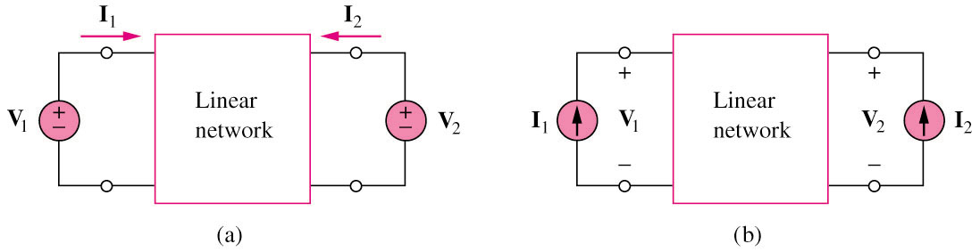
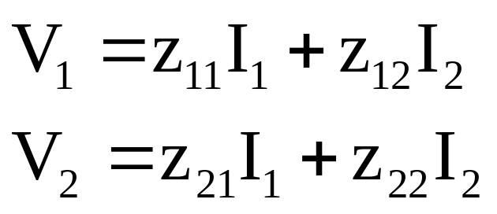
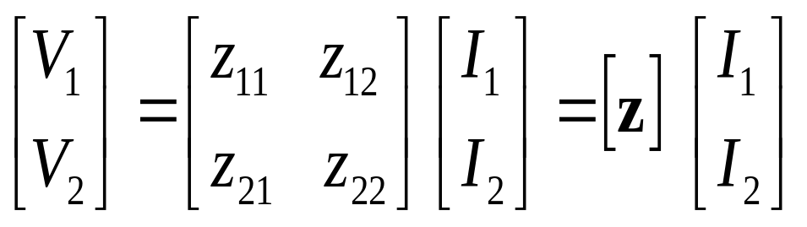
19.2 Impedance parameters (1)
Assume no independent source in the network
where the z terms are called the impedance parameters, or simply z parameters, and have units of ohms.

Slide 7
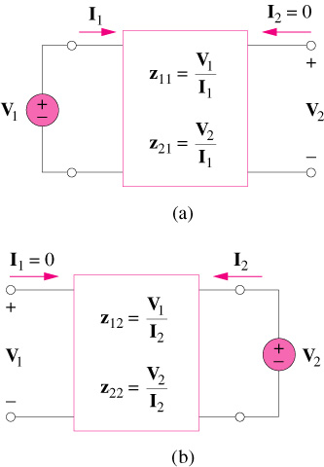
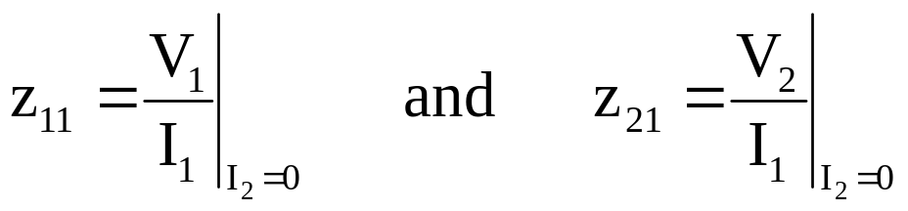
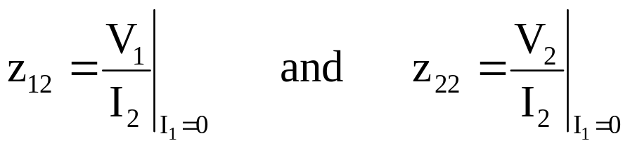
19.2 Impedance parameters (2a)
z₁₁ = Open-circuit input impedance
z₂₁ = Open-circuit transfer impedance from port 1 to port 2
z₁₂ = Open-circuit transfer impedance from port 2 to port 1
z₂₂ = Open-circuit output impedance

Slide 8


19.2 Impedance parameters (2b)
When z₁₁ = z₂₂, the two-port network is said to be symmetrical.
When the two-port network is linear and has no dependent sources, the transfer impedances are equal (z₁₂ = z₂₁), and the two-port is said to be reciprocal.

Slide 9
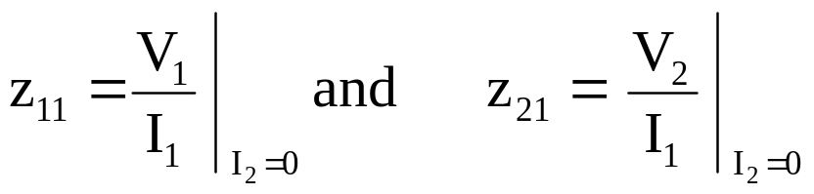
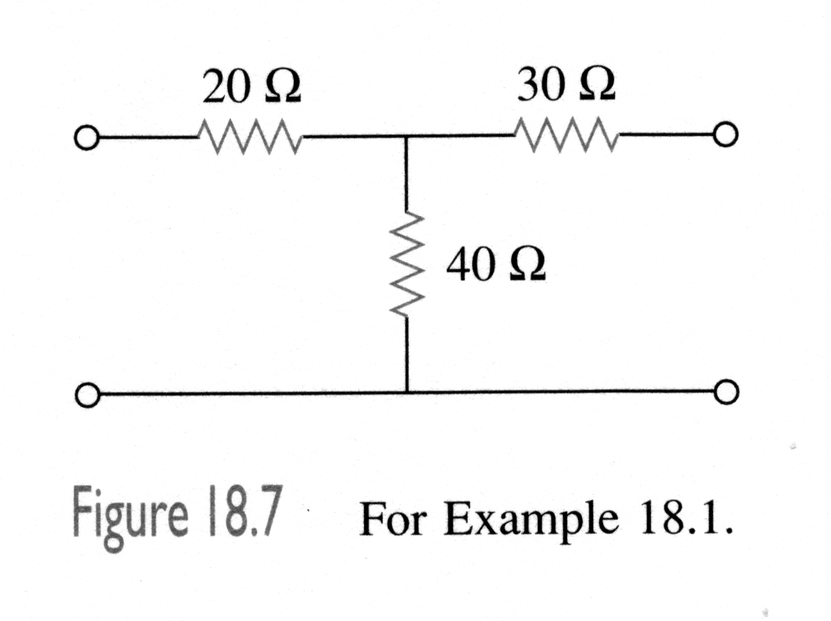
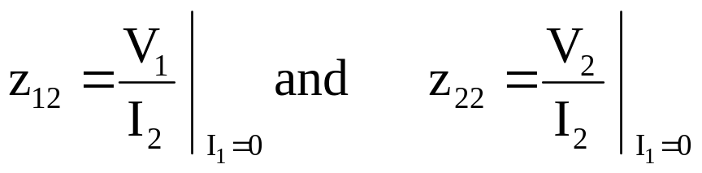
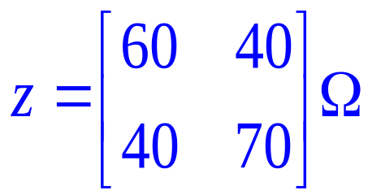
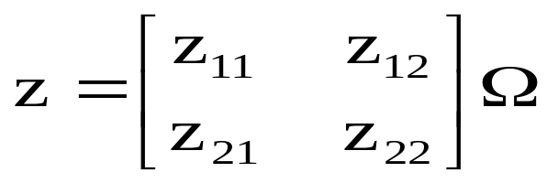
19.2 Impedance parameters (3)
Example 1
Determine the Z-parameters of the following circuit.
I₁
I₂
+
V₁
₋
+
V₂
₋
Answer:

Slide 10

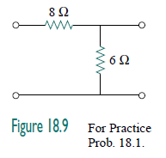


Slide 11
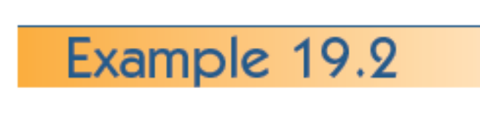
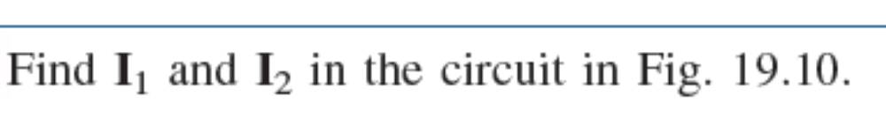
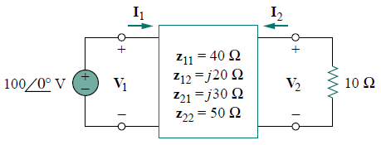








Slide 12
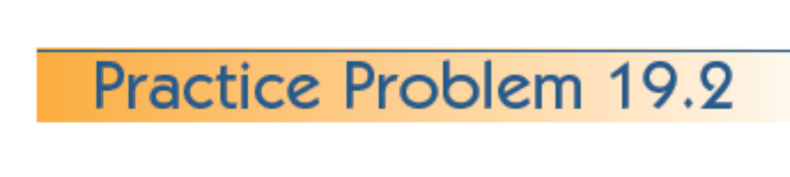
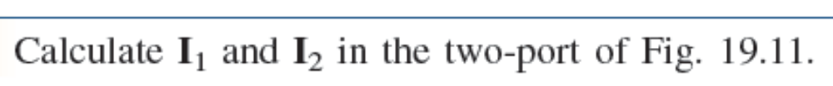
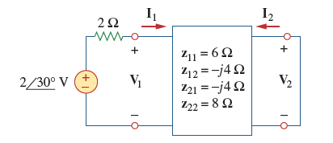
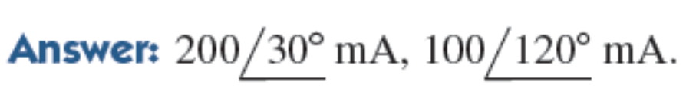

Slide 13
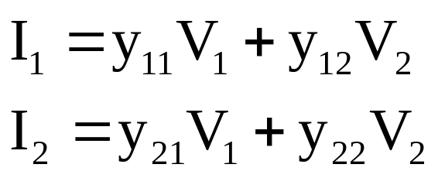
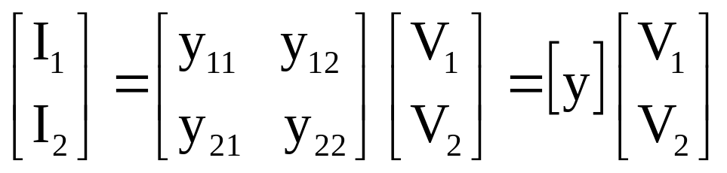
19.3 Admittance parameters (1)
Assume no independent source in the network
where the y terms are called the admittance parameters, or simply y parameters, and they have units of Siemens.

Slide 14
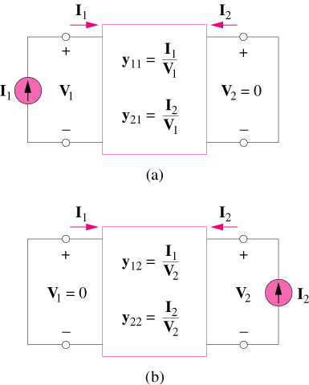
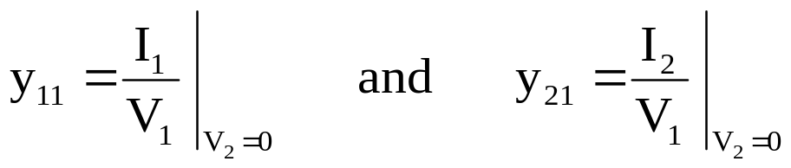

19.3 Admittance parameters (2)
y₁₁ = Short-circuit input admittance
y₂₁ = Short-circuit transfer admittance from port 1 to port 2
y₁₂ = Short-circuit transfer admittance from port 2 to port 1
y₂₂ = Short-circuit output admittance

Slide 15
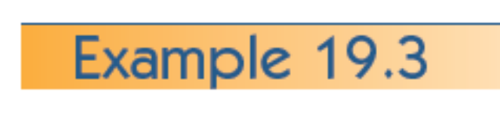
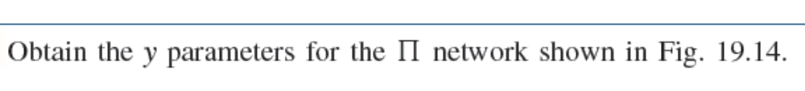
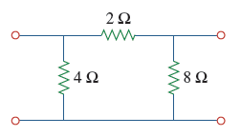
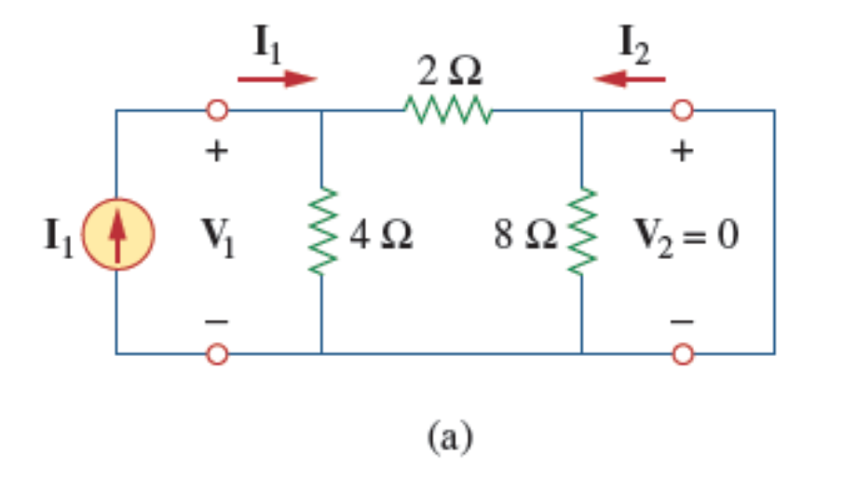
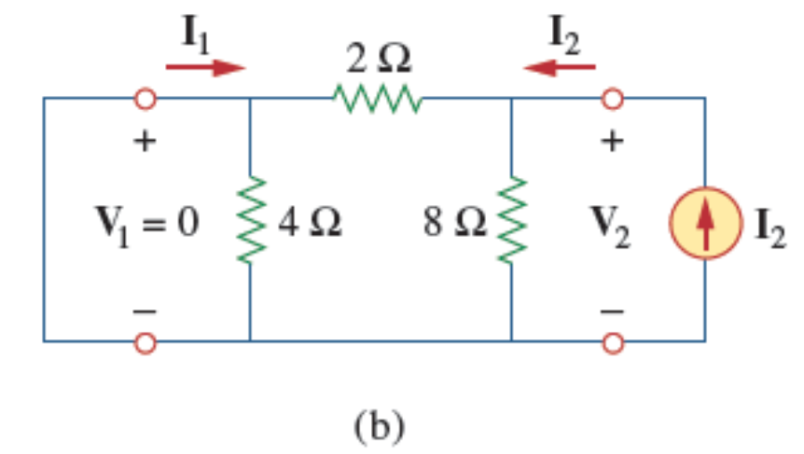

Slide 16

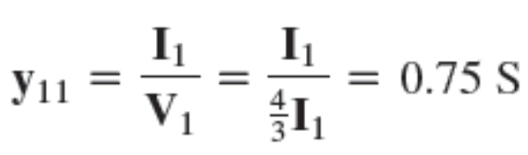

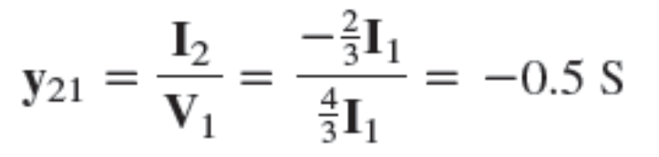
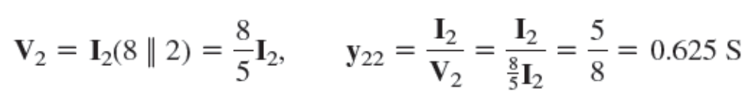


Slide 17
Impedance parameters
Assume no independent source in the network
where the z terms are called the impedance parameters, or simply z parameters, and have units of ohms.

Slide 18
Admittance parameters
Assume no independent source in the network
where the y terms are called the admittance parameters, or simply y parameters, and they have units of Siemens.

Slide 19
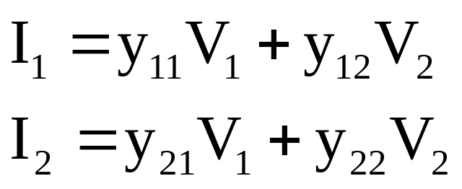
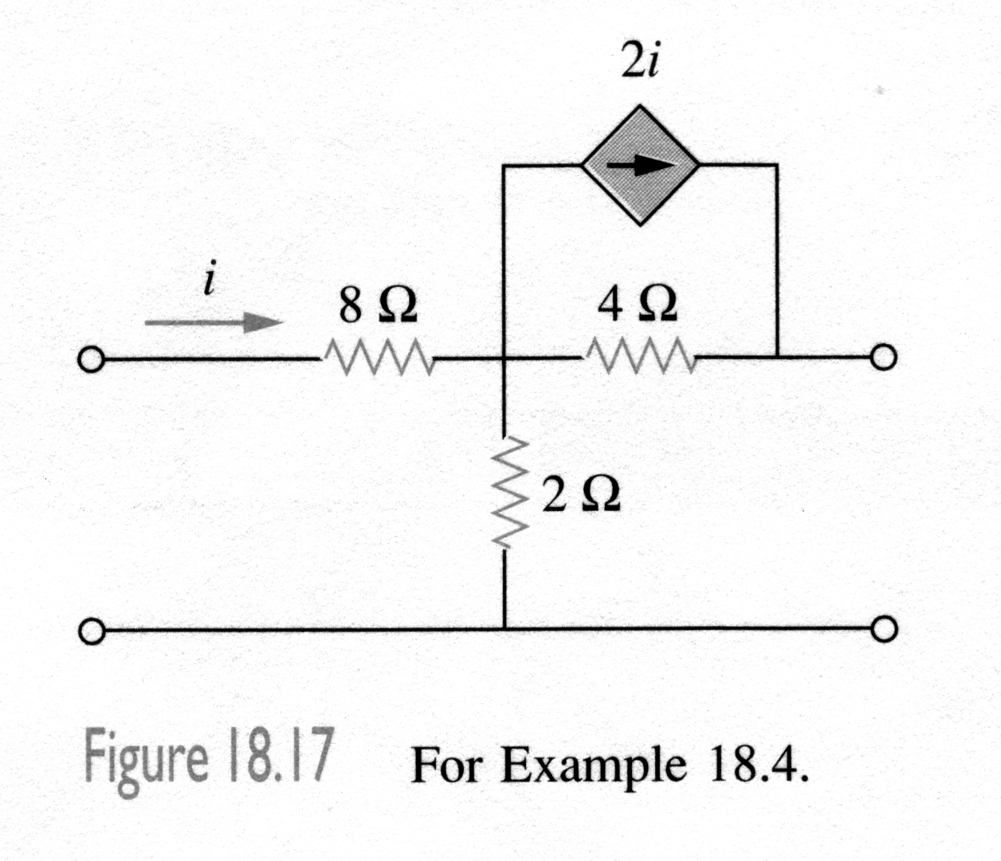
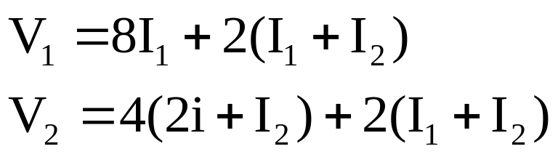
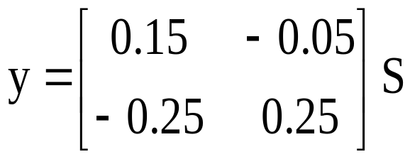
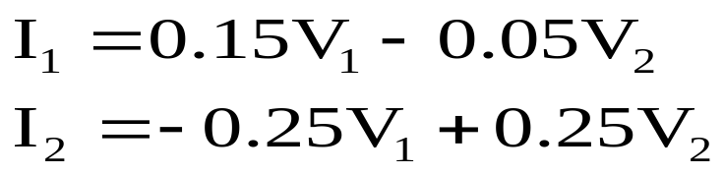
Example 19.4
Determine the y-parameters of the following circuit.
I₁=i
I₂
Apply KVL
+
V₁
-
+
V₂
-
Answer:

Slide 20
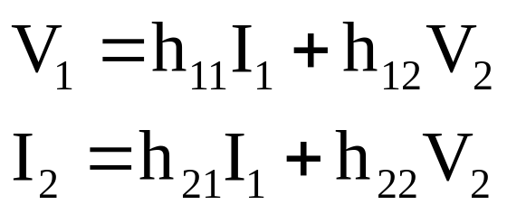
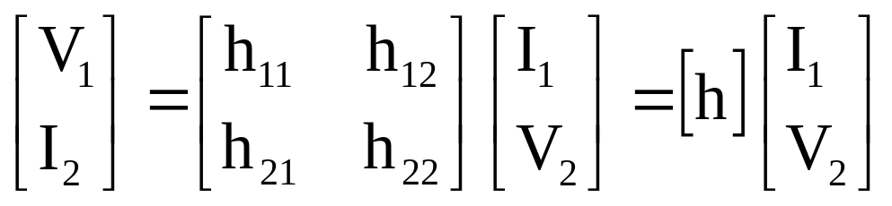
19.4 Hybrid parameters (1)
Assume no independent source in the network
where the h terms are called the hybrid parameters, or simply h parameters, and each parameter has different units, refer above.

Slide 21
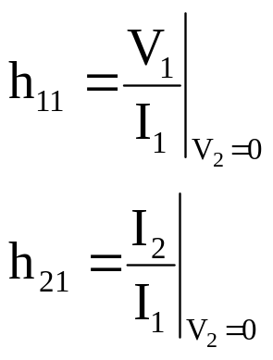
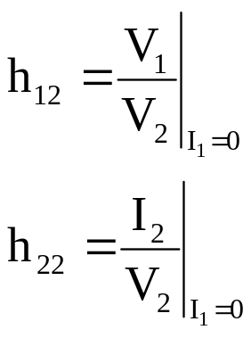
19.4 Hybrid parameters (2)
h₁₁= short-circuit input impedance (Ω)
h₁₂ = open-circuit reverse voltage-gain
h₂₁ = short-circuit forward current gain
h₂₂ = open-circuit output admittance (S)

Slide 22
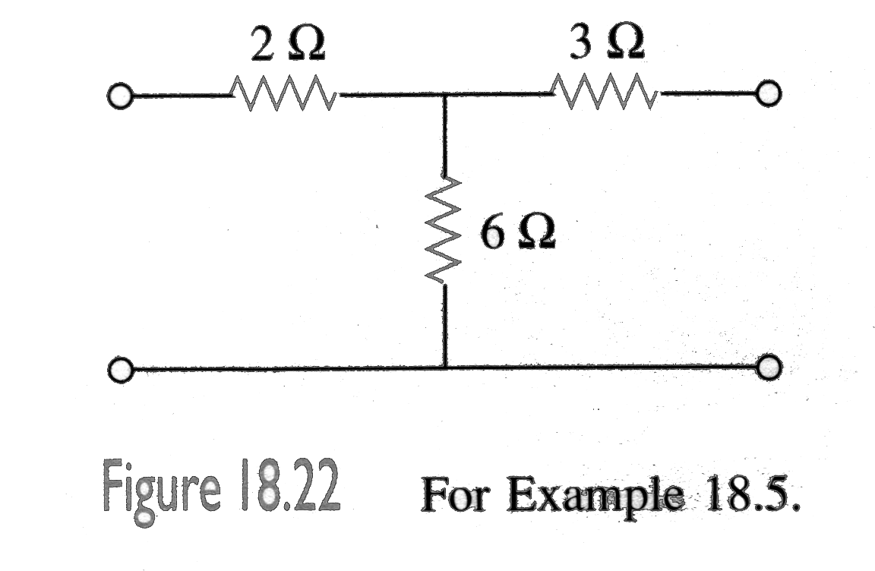
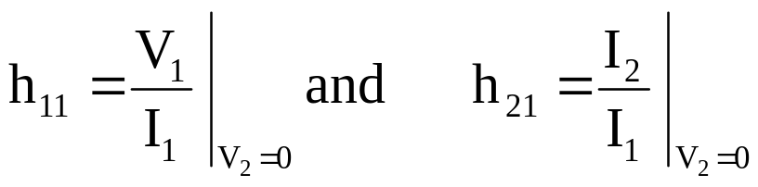
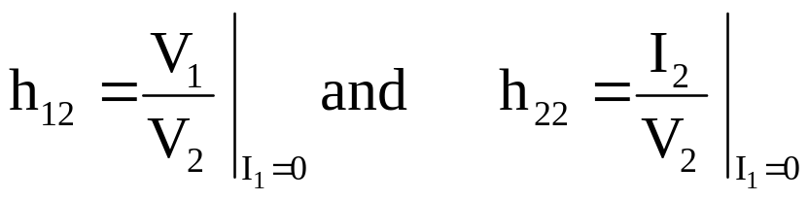
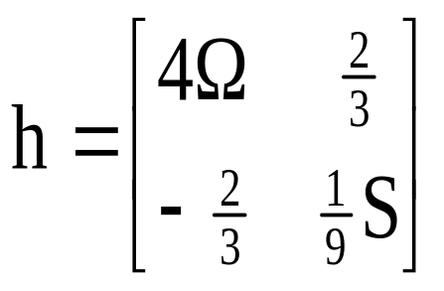
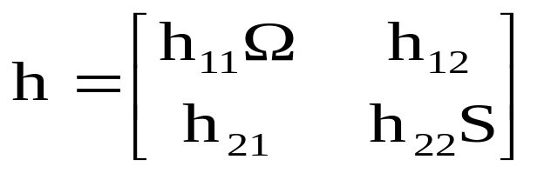
Example 4
Determine the h-parameters of the following circuit.
I₁
I₂
+
V₁
-
+
V₂
-
Answer:

Slide 23
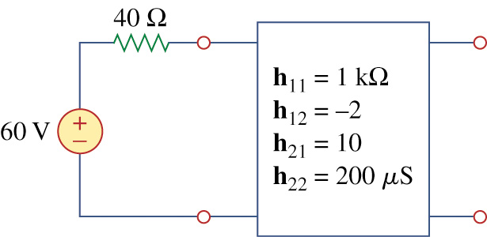
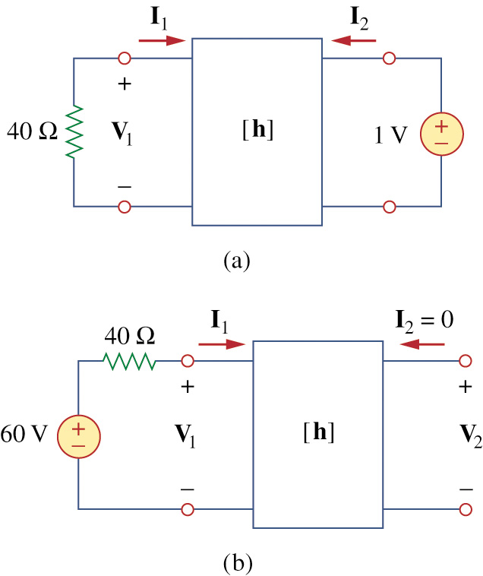
Example 5
Determine the Thevenin equivalent at the output port of the circuit shown in the following Fig.

Slide 24
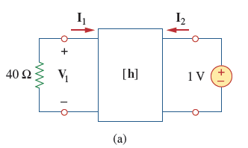
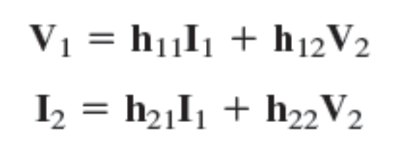








Slide 25









Slide 26





19.5 Inverse hybrid parameters
g₁₁=open-circuit input admittance(S)
g₁₂ = Short-circuit reverse current-gain
g₂₁ = open- circuit forward voltage gain
g₂₂ = short-circuit output impedance (Ω)

Slide 27



19.6 Transmission parameters (1)
Assume no independent source in the network
where the T terms are called the transmission parameters, or simply T or ABCD parameters, and each parameter has different units.

Slide 28



19.6 Transmission parameters (2)
A=open-circuit voltage ratio
B= negative short-circuit transfer impedance (Ω)
C= open-circuit transfer admittance (S)
D=negative short-circuit current ratio

Slide 29





Example 6
Determine the T-parameters of the following circuit.
Apply KVL
+
V₁
-
+
V₂
-
Answer:

Slide 30









Slide 31








Slide 32




19.7 Inverse Transmission parameters
Inverse transmission parameters are defined by expressing the variables at the output port in terms of the variables at the input port.
a=open-circuit voltage gian
b= negative short-circuit transfer impedance (Ω)
c= open-circuit transfer admittance (S)
d=negative short-circuit current gain

Slide 33



19.8 Interconnection of Networks(1)
1. The series connection of two-port networks
The series connection of two-port networks is shown in following Fig.. For the series connection, the input currents of the ports are the same and their voltage add.
For network N_{a,}
For network N_{b,}

Slide 34




19.8 Interconnection of Networks(2)
We notice that from above Fig.
and that
Thus, the z parameters for the overall network are
or
Showing that the z parameters for the overall network are the sum of the z parameters for the individual network. This can be extended to n networks in series.

Slide 35



19.8 Interconnection of Networks(3)
2. The parallel connection of two-port networks
Two two-port networks are in parallel when their port voltages are equal and the port currents of the lager network are the sums of the individual port currents. The parallel connection of two two-port networks is shown in following Fig.
For network N_{a,}
For network N_{b,}

Slide 36



19.8 Interconnection of Networks(4)
But from above Fig., we can get
From these equations, we obtain
Thus, the y parameters for the overall network are

Slide 37



19.8 Interconnection of Networks(5)
3. The cascaded connection of two-port networks
Two networks are said to cascaded when the output of one is the input of the other. The connection of two two-port networks in cascade is shown in following Fig. For the two networks,

Slide 38



From above Fig.,
From these equations , we obtain
Thus, the transmission parameters for the overall network are the product the transmission parameters for the individual transmission parameters:

Slide 39


Practice Find the ABCD parameters in the circuit in following Fig.
Answer :

Slide 40
SUMMARY(1)
A two-port network is one with two ports ( two pairs of access terminals), known as input and output ports.
The six parameters used to model a two-port network are the impedance [z], admittance [y], hybrid [h], inverse hybrid [g], transmission [T], and inverse transmission [t] parameters.
The parameters can be calculated or measured by short-circuiting or open-circuiting the appropriate input or output port.
A two-port network is reciprocal if z₁₂=z₂₁, y₁₂=y₂₁, h₁₂=-h₂₁, g₁₂=-g₂₁, Δ_{T}=1, Δ_{t}=1. Network containing dependent sources are generally not reciprocal.

Slide 41
SUMMARY(2)
Two –port network may be connecte in series, in parallel,or in cascade. In the series connection the z parameters are added, in the parallel connection the y parameters added, and in the cascade connection the transmission parameters are multiplied in the correct order.

Slide 42
Assignment (page 895)
Problems 19.3, 19.13, 19.15, 19.31, 19.45

